Slide 1
Conveyor Belt Proposal
VFA Team

Slide 2
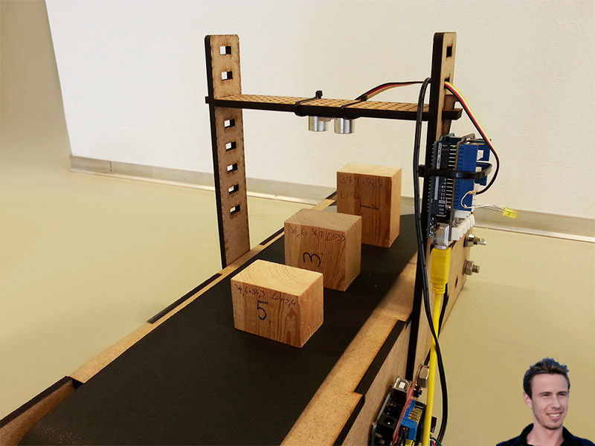
Overall model

Slide 3
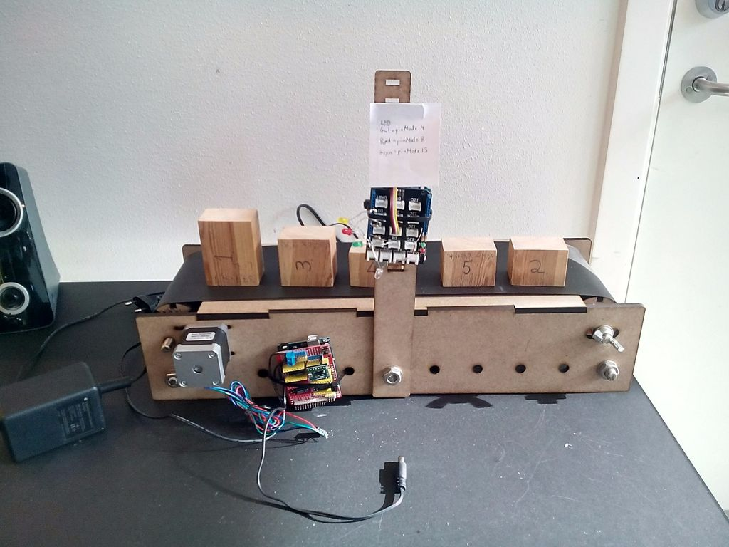

Slide 4
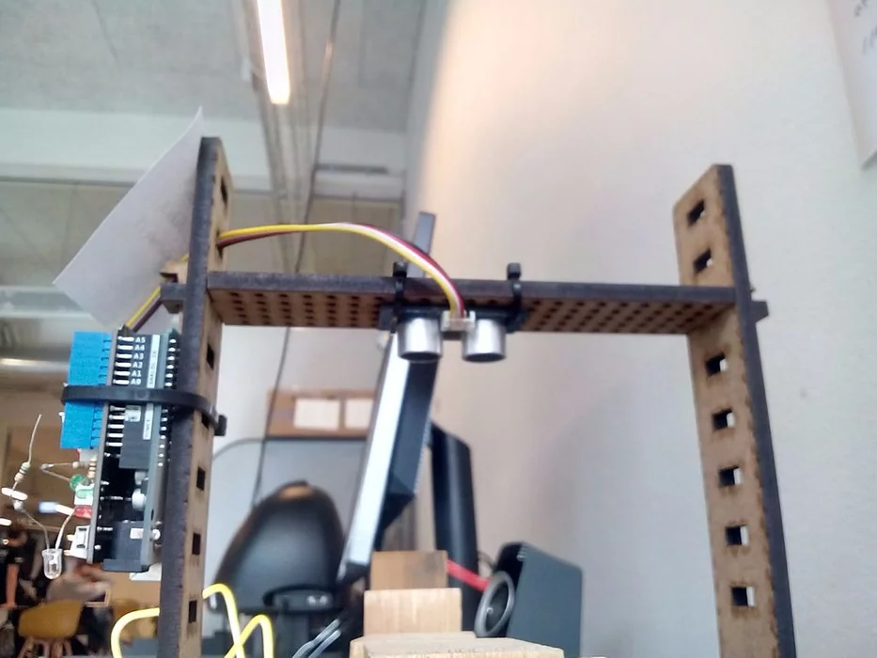

Slide 5
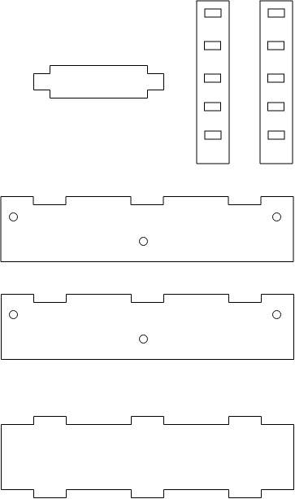

Slide 6
Components
Distant Sensor: (120k) - https://icdayroi.com/module-cam-bien-lazer-5v-ky-008 - https://icdayroi.com/cam-bien-vat-can-hong-ngoai-e18-d80nk (cảm biến này có thể vặn biến trở điều chỉnh khoảng cách phát hiện -> giảm nhiễu) - http://hshop.vn/products/cam-bien-vat-can-hong-ngoai-e18-d80nk-4
http://hshop.vn/products/cam-bien-sieu-am-srf05
Arduino: (135k) - http://hshop.vn/products/arduino-uno-r3 (kèm cáp + vỏ)
Adapter: (32k) - http://hshop.vn/products/nguon-adaptor-ac-dc-9v-1a
Accessories: (~100k) - http://hshop.vn/products/day-camtest-board-coicoi10cm40soi - http://hshop.vn/products/day-camtest-board-duc-duc-10cm40soi - http://hshop.vn/products/test-board-cammb-102

Slide 7
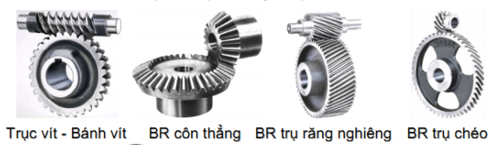
5. Motor (160k) http://hshop.vn/products/dong-co-dc-giamtoc-ga37-100rpm
6. Gears

Slide 8
7. Băng chuyền ( vải hoặc giấy) 8. Phụ tùng giá đỡ, ốc vít…. ( thanh ren M10)

